Slide 1
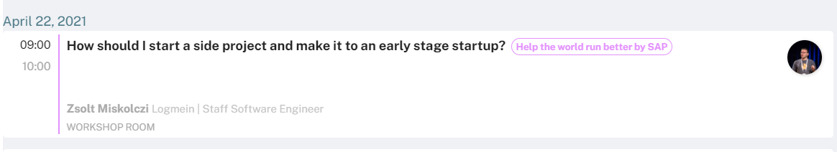

Slide 2
Technical details
Question format:
Audio: please feel free to interrupt me
Text: [<topic>]: <question>
[pink unicorns]: why they are pink?
Reward format:
Email to zsolt.miskolczi@logmein.com this week
Hey, at the topic of pink unicorn, you told me to send you my contact to get …

Slide 3
How should I start a startup?

Slide 4
Startup 101

Slide 5
How should I start a side project?

Slide 7
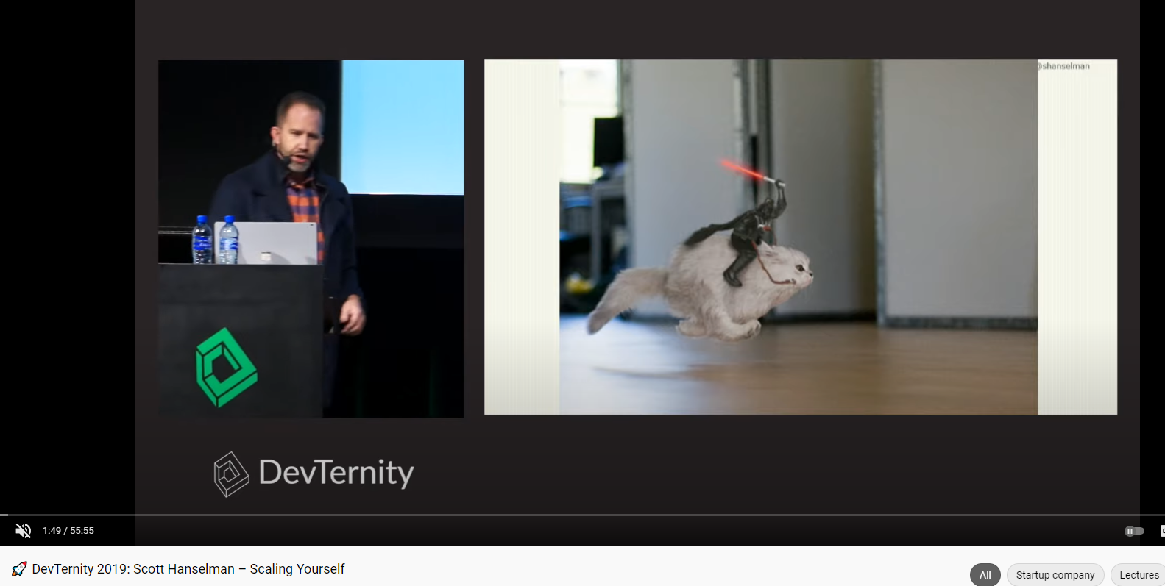

Slide 8
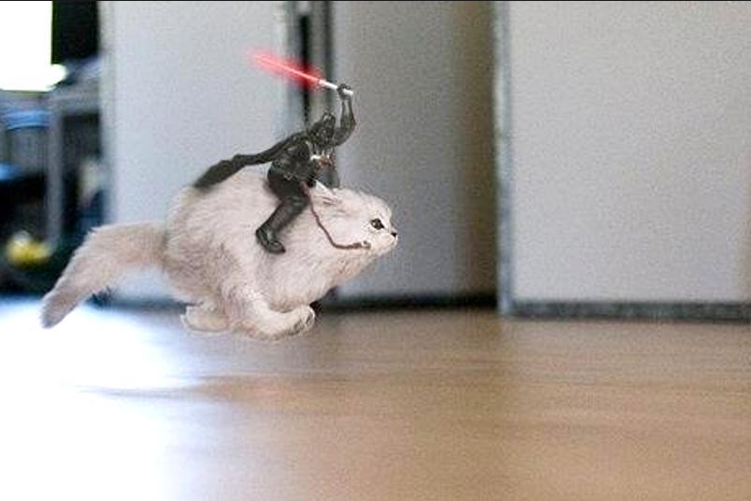

Slide 9
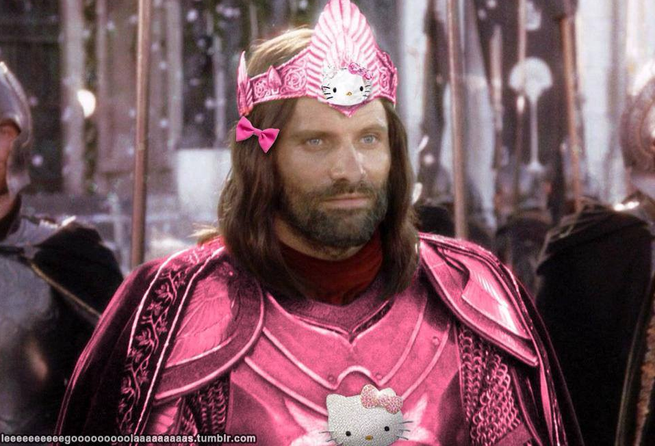

Slide 10
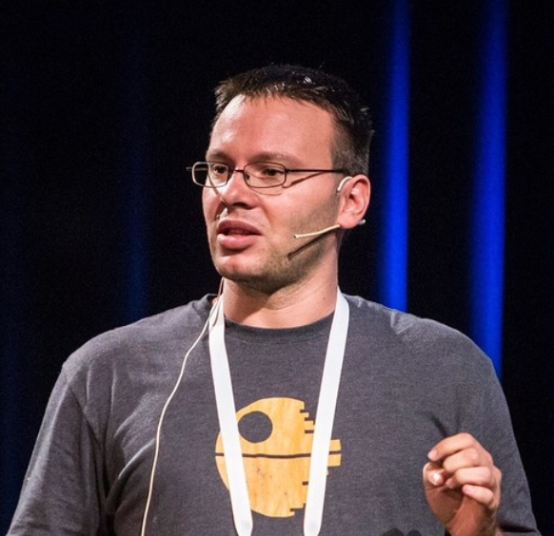

About me
Software Engineer at LogMeIn
Former full-stack engineer
Hired as a database engineer
Currently a back-end engineer
One wife
Two kids

Slide 11

About me

Slide 12
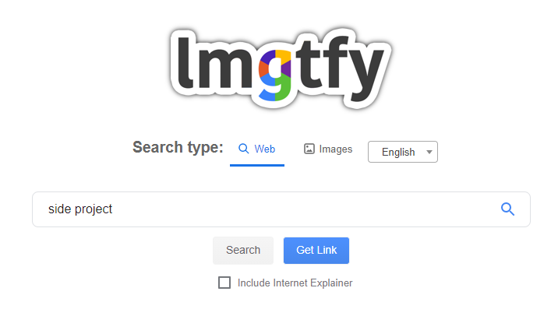

Slide 13
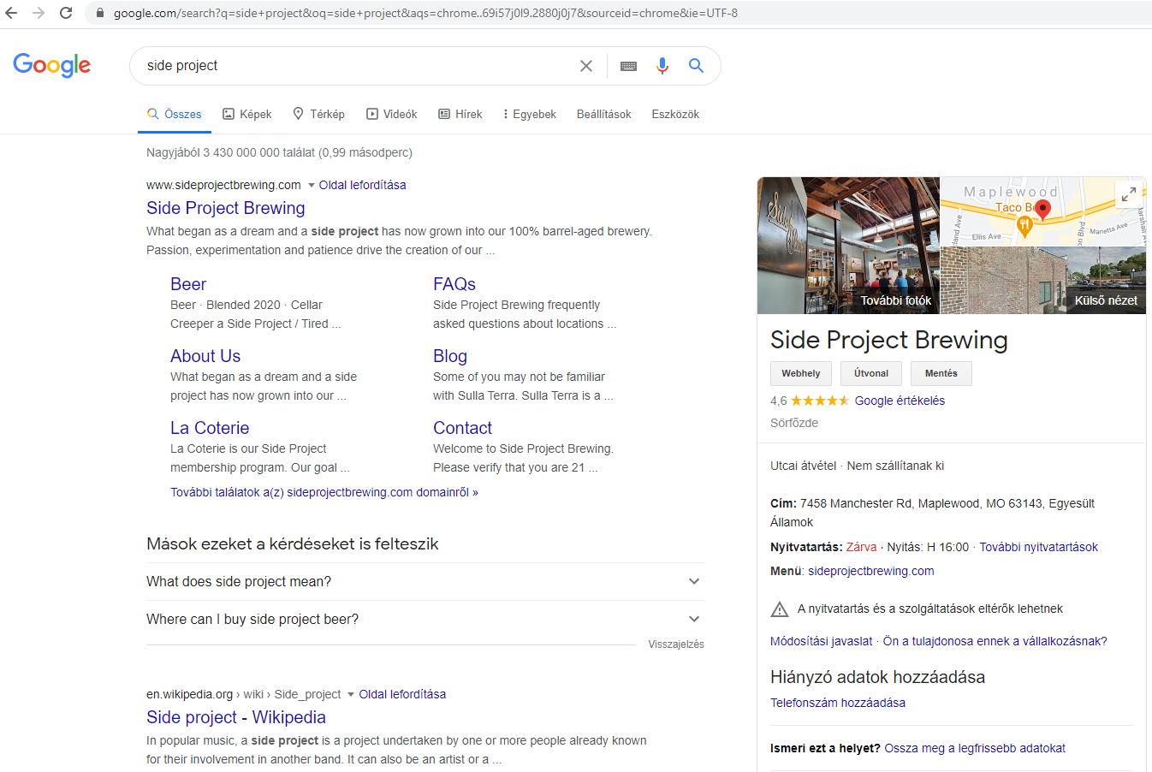

Slide 14
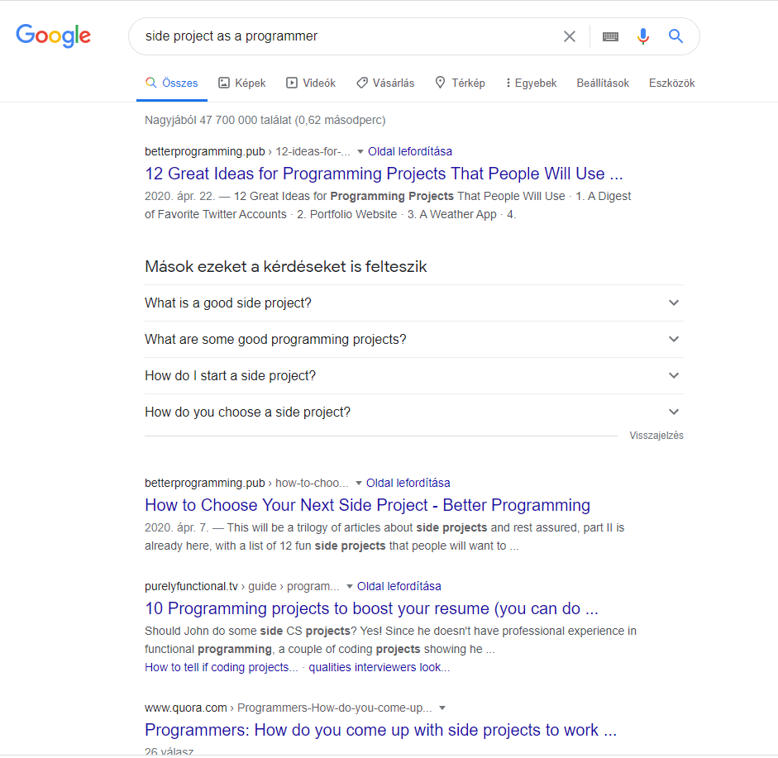

Slide 15
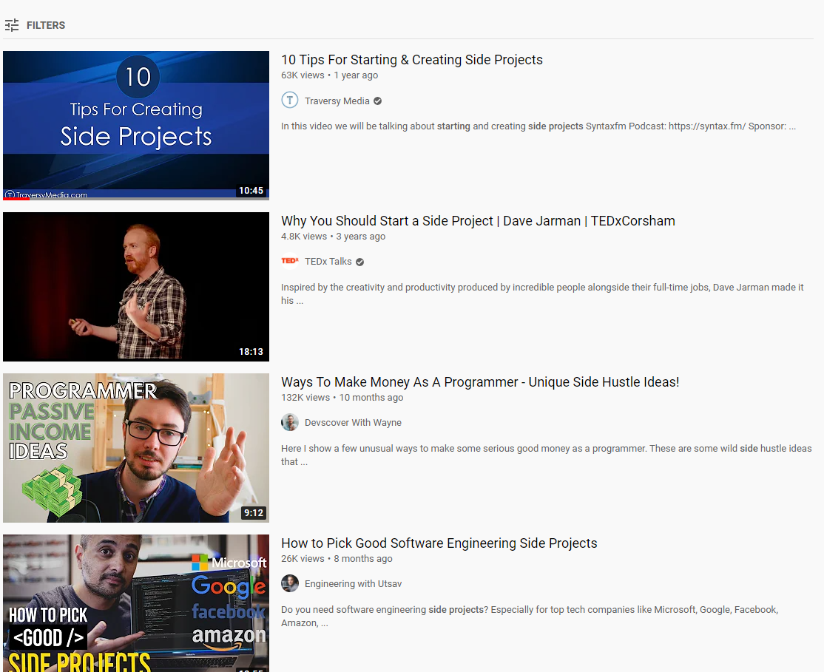

Slide 16
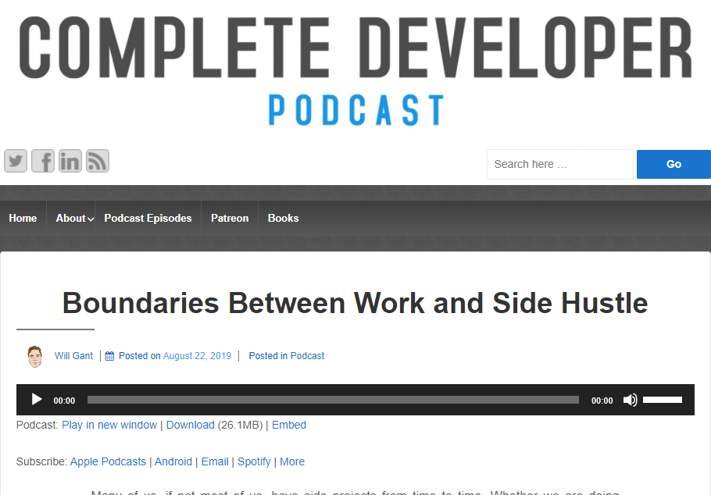

Slide 17
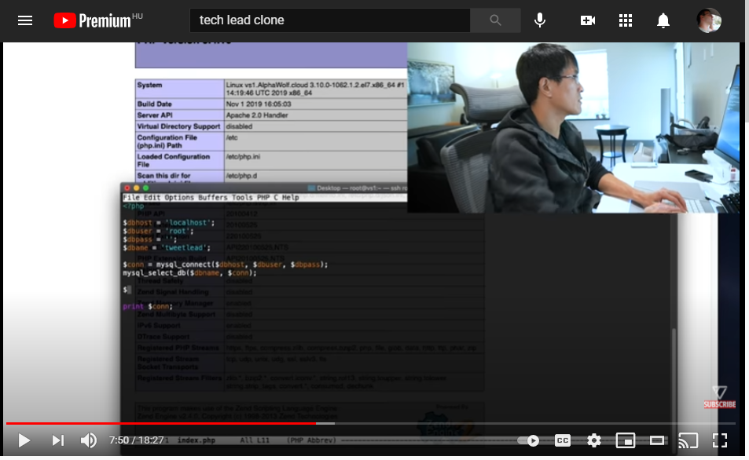

Slide 18
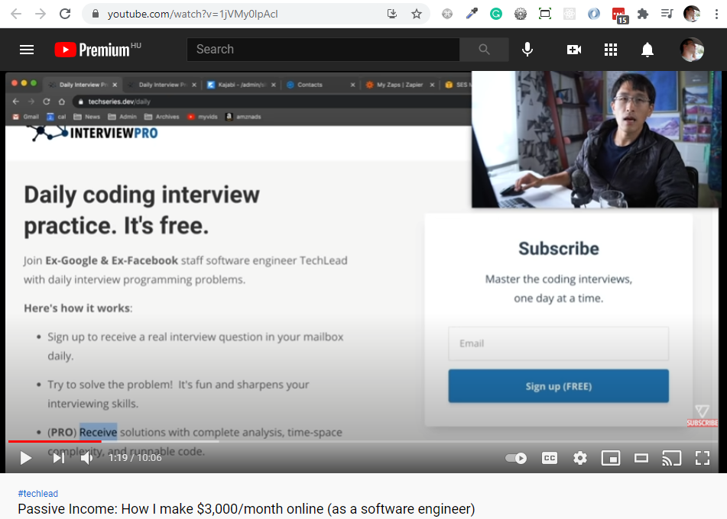

Slide 19
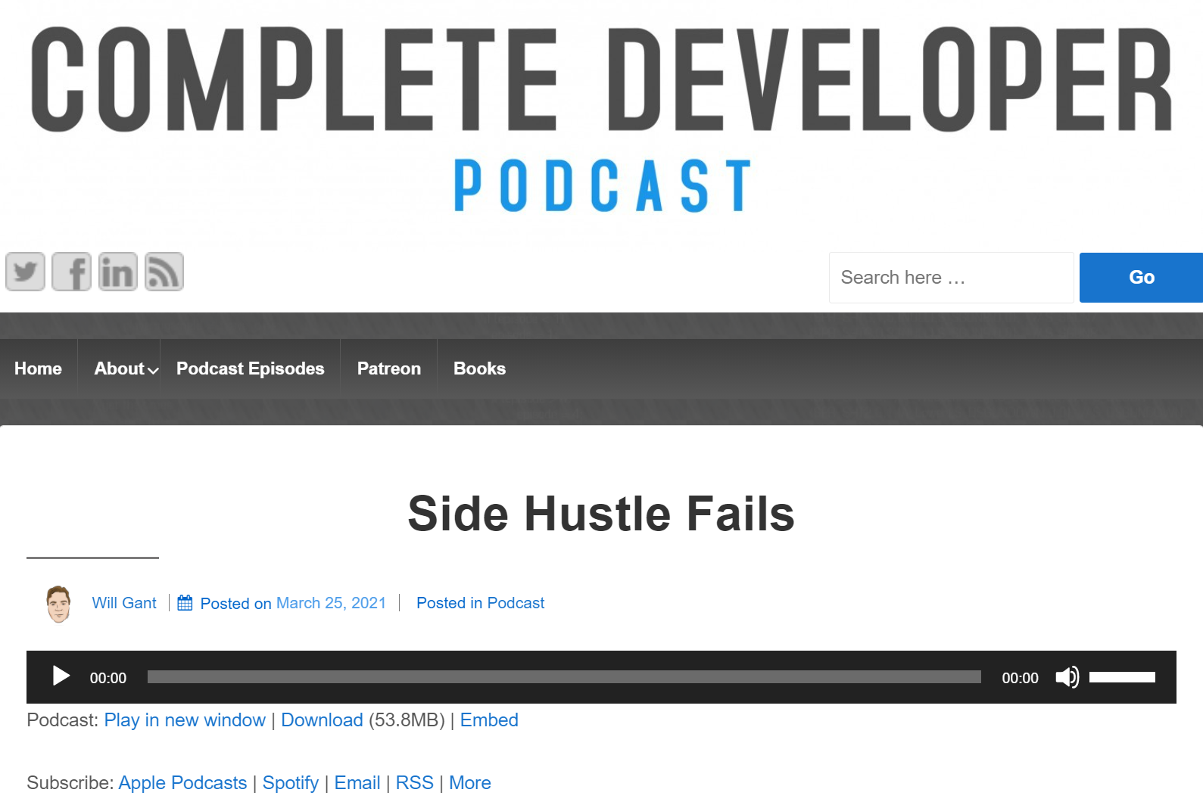

Slide 20
What is a side project?

Slide 21
What is not a side project?
NOT a learning project
NOT an enterprise business
NOT the thing that gives you guarantee you can pay your bills

Slide 22
When to start a side project?
I’m too young, I have to learn
I gain some experience – maybe later
I get a girl first
I’m full of work, I make a safety pocket (tons of money). So now I’m focusing on putting money a side and work a lot.
I pay my house first
I grew my kids first

Slide 23
So what is the goal of our side project?
Make some income on a side
Create my own business
Retire early
Make tons of money
Or get reputation

Slide 24
Simple goal
Generate some money
Find ways to increase the money earned

Slide 25
Embrace speed

Slide 26
ASAP is late!

Slide 27
When to work on it?

Slide 28

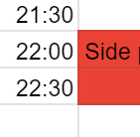
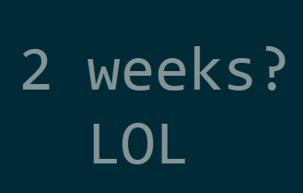
!(9AM-5PM)
Schedule time
Really quick sprints

Slide 29
What?

Slide 30

Figure out yourself

Slide 31
Talk – a lot
One liner
All features
MVP/Key features/features later
Pricing model
Interview possible customers

Slide 32
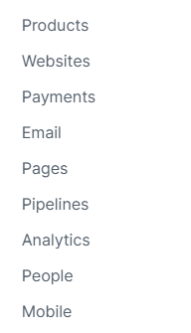


Landing page and other stuff
Don’t code if you don’t need to
WordPress
Kajabi

Slide 33
Tech stack

Slide 34
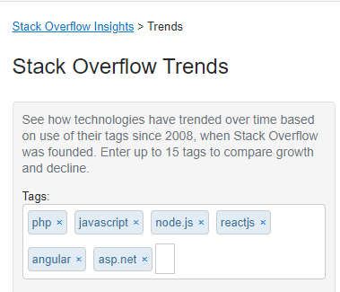
Tech stack (for web)– what I thought
PHP with some JS – it is cheap to hire people
Full stack JavaScript: Node and React (or Angular) – popular. Easy to hire people

Slide 35
Tech stack – ask some people
It depends on. What is the startup? I would pick something I know well to deliver my first prototype fast.
Why should you ****** with a technology that you don’t know?
Monolith as rule of thumb. As simple as it possible, just to make sure it is trivial to develop.
The project decides it.
I would choose what I know. The stack shouldn’t distract your attention from the project

Slide 36
Learning project != side project

Slide 37
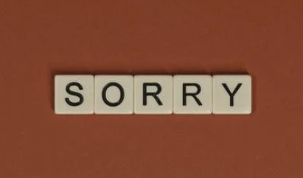
Learning VS Side - Let’s compare speed

Slide 38
Equipment

Slide 39
Equipment - BYOD
Bring Your Own Device
Make sure there can be no legal case

Slide 40
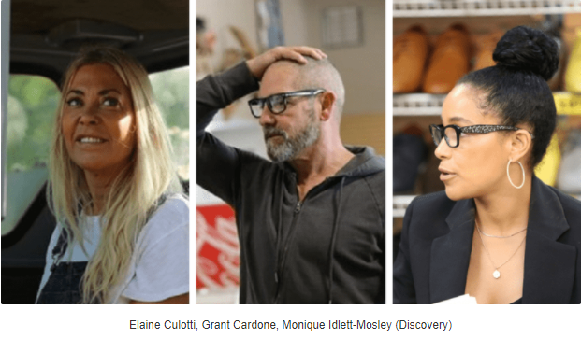

Slide 41
Identity

Slide 42
Build your own
Login and register
Email validation
Forgot password change
Captcha
Attacks from various and exotic places
Legal issues (is your identity stuff GDPR compatible?)

Slide 43
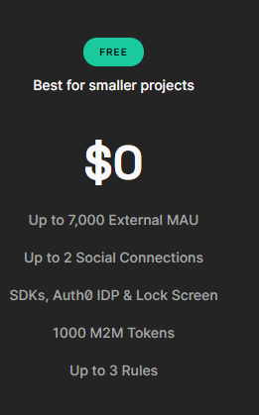
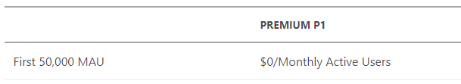
Use existing solutions
Build your own
Azure Identity
Auth0

Slide 44
Logging

Slide 45
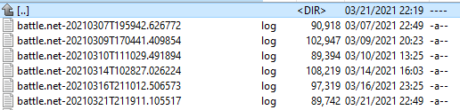
Logging

Slide 46
Database

Slide 47



Database
Relational OR NoSQL?
Cheap OR Expensive?
Self-hosted OR Database as a service?

Slide 48
Support

Slide 49
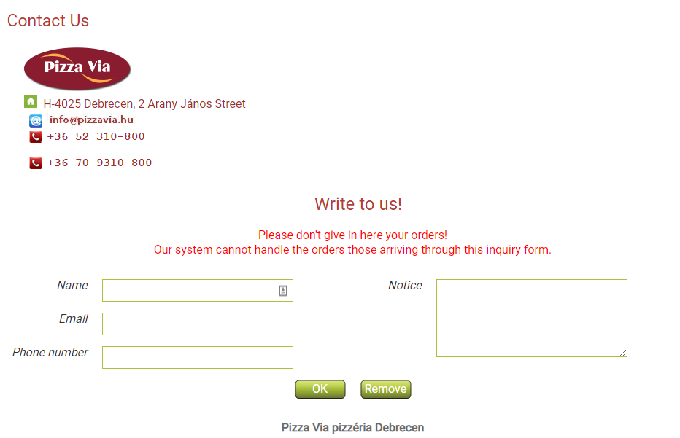
Support

Slide 50
Please email as at support@myfancyflowershop.com

Slide 51


Slide 52
Minimal expertise
10 years of expertise about 7/24 systems
50 years Angular
Database performance tuning
Mentoring, coaching and leadership experience
Salary requirement: zero to none

Slide 53


Who to work with - I

Slide 54
Who to work with - II
Trust
Want’s to do
Has free time
Committed to work
Don’t do it alone!

Slide 55
Final thoughts

Slide 56

Enterprise development != Startup development

Slide 57
Startup development != Side project development

Slide 58
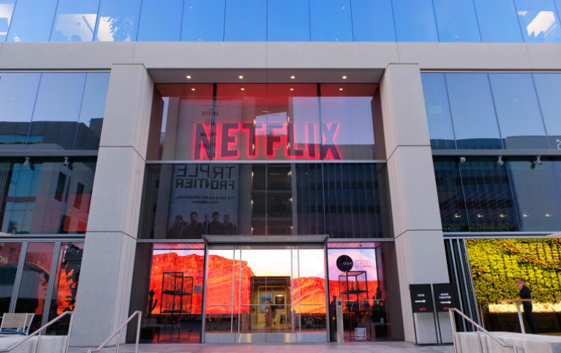
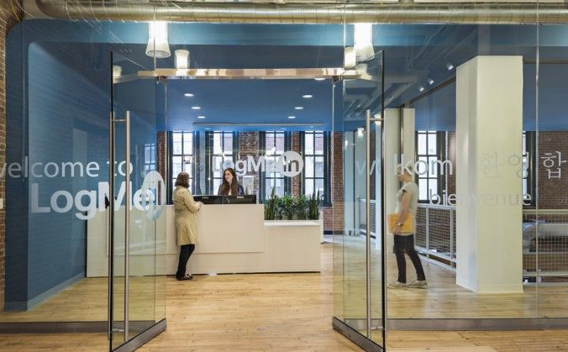
Enterprise

Slide 59
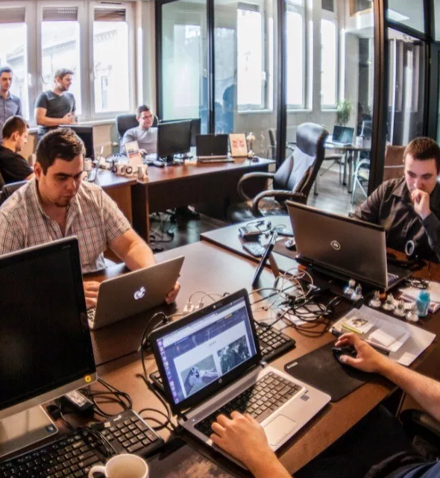
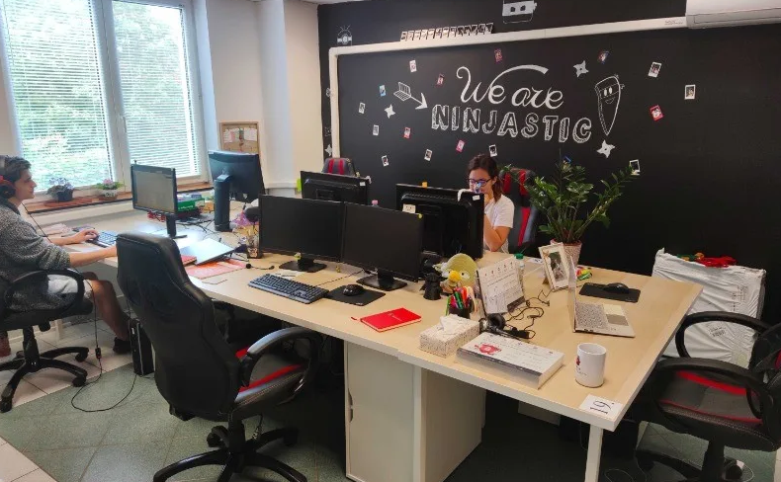
Startup

Slide 60


Home office

Slide 61


Covid office

Slide 62
Q/A

Slide 63
Thank You

